Slide 1
Tugas 4 APIC Basic Gates
I Made Medika Surya W.M – 13222021

Slide 2
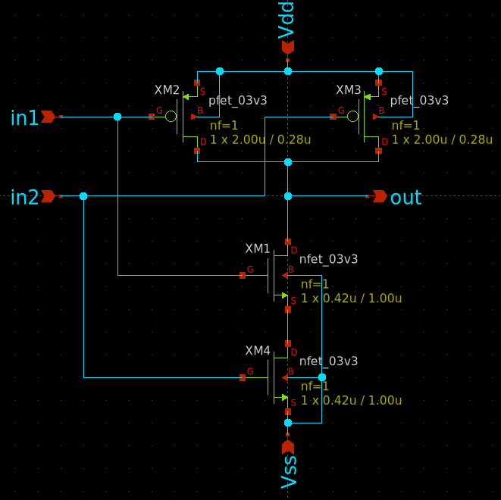
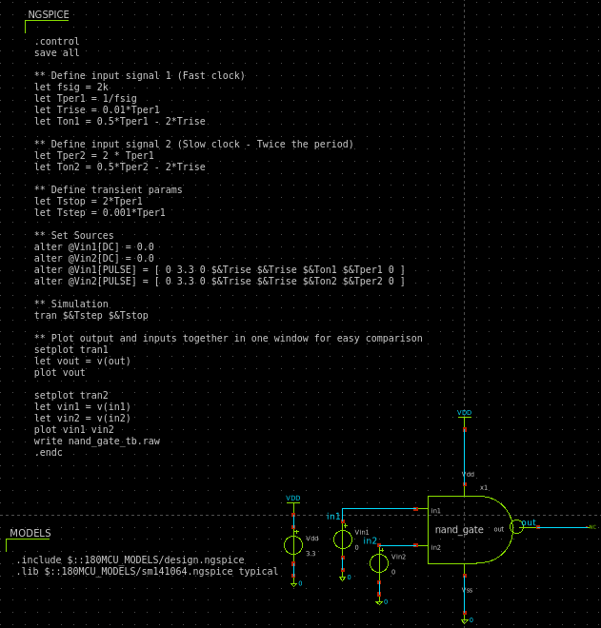
Schematic di xschem dan NgSpice

Slide 3
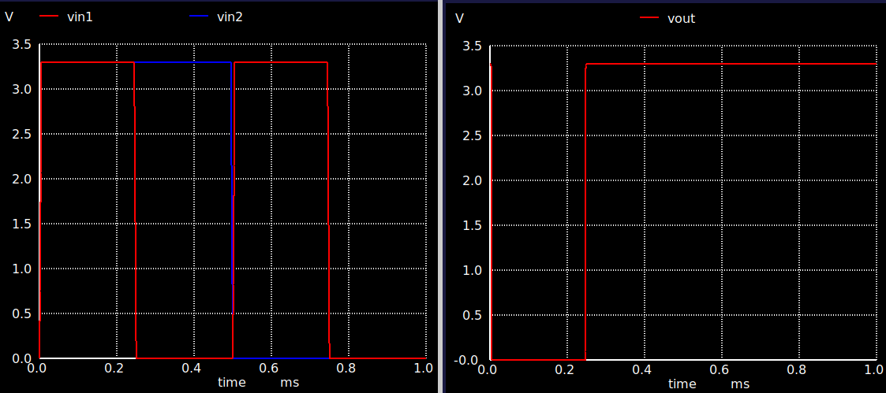
LVS menggunakan Klayout

Slide 4
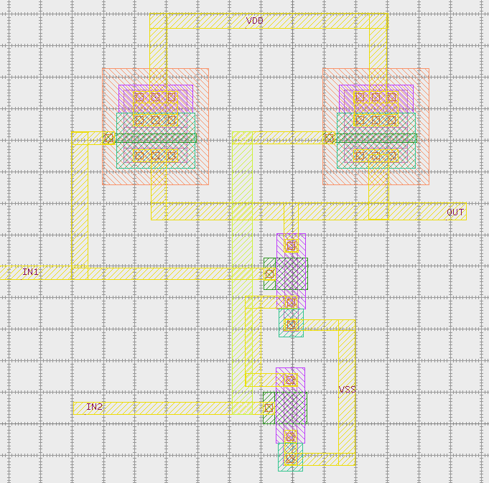
Layout menggunakan K - Layout

Slide 5
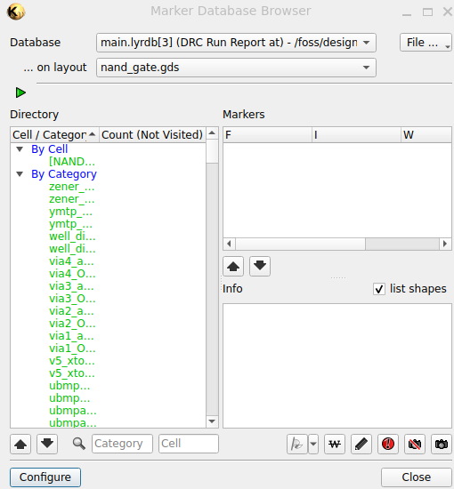
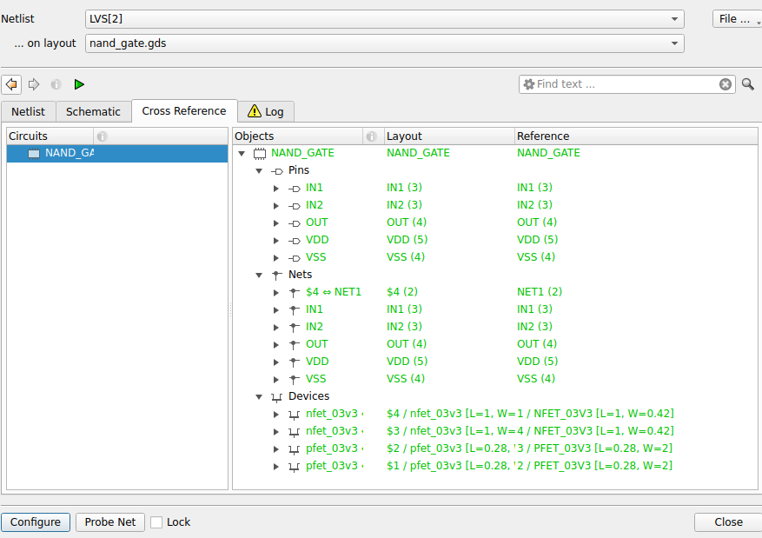
DRC - LVS

Slide 6
Referensi
https://www.youtube.com/watch?v=MdywD87-DVg
https://www.youtube.com/watch?v=DLvZSsLAbho
https://www.youtube.com/watch?v=nBnR8Nm_B_I&t=6s
https://www.youtube.com/watch?v=vamfMryYPS4
https://www.youtube.com/watch?v=U21oAbeKTNo
https://www.youtube.com/watch?v=40qe4hXG6Kk

